Slide 1
OVERVIEW
Create a new project in Rstudio Cloud
Moving around the Rstudio interface
Install the tidyverse and ggplot2 packages
Open a new script file
Using script that we have already prepared for you we will
Create a RMarkdown Document ready for publishing in HTML format

Slide 2
Rstudio Integrated Development Environment
3 options –
Open source Server – which is what we will be using today
Desktop IDE that you can install onto your desktop, you will be responsible for updating the software
Professional Servers for teams and large collaboration projects
Open RStudio cloud and create a new project
Windows We will refer to the four windows as
Top left - Source code Top Right - Environment
Bottom left - Console Bottom Right - Files

Slide 3
Upload/Retrieving the script file
From the menu bar Create a new script file
Go to the link that I am putting into the chat
https://github.com/amandajcole/DASA_IV20_DATAVIZ_WORKSHOP/blob/master/script1%20_IV20_DataViz_Workshop.R
*Copy all of the lines from 1 to 109 and past into the script file

Slide 4
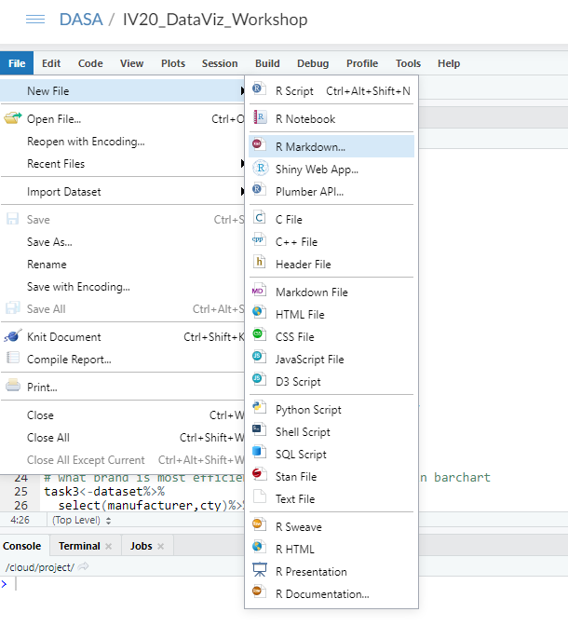
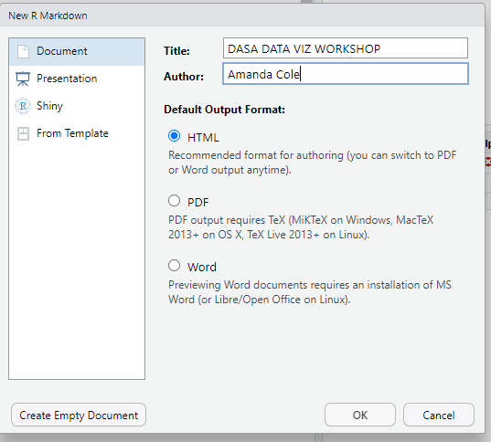
Create a New R Markdown File – HTML format

Slide 5
Components of the Rmarkdown File
First let us save our file
Click on the save button and save your file
The structure of the RMD File includes:
Lines 1-6 in the source code are the meta data, we will leave this as it is for the purpose of the workshop.
The shaded areas indicate the lines of code which will be run each time you KNIT the file.
Knitting is the term used to bring the code and the text together into the single document ready for publishing.

Slide 6
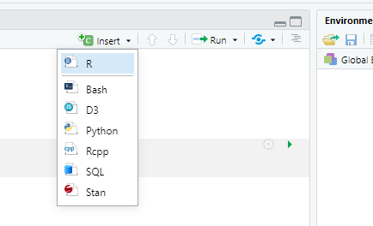
Install the packages into the project
Insert an R Chunk
Copy lines 1-5 and paste them in the R Chunk
Move the title ## Step 1 Install the packages
out of the code chunk. The ## indicate that this is to be formatted as a level 2 header.
Now we must run this code

Slide 7
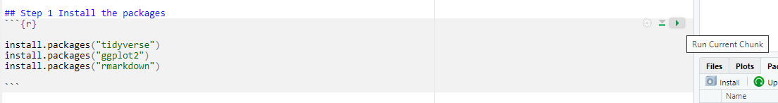
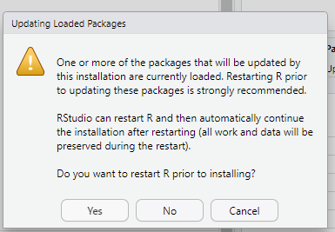
Run the code
Click yes if you get this warning
Once the packages are installed you need to comment them out as we only need to install them once for each project.
Now we need to load the libraries
Copy the code from line 8-10 into R chunk 2 and run it

Slide 8
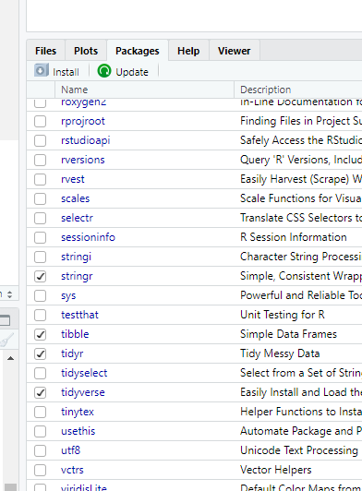
Loading the Libraries
Copy the code from line 8-10 into R chunk 2 and run it
You can confirm that the libraries are installed by activating the packages tab, scrolling down to each package and the ones that are ticked are loaded
NOW WE ARE READY TO GO

Slide 9
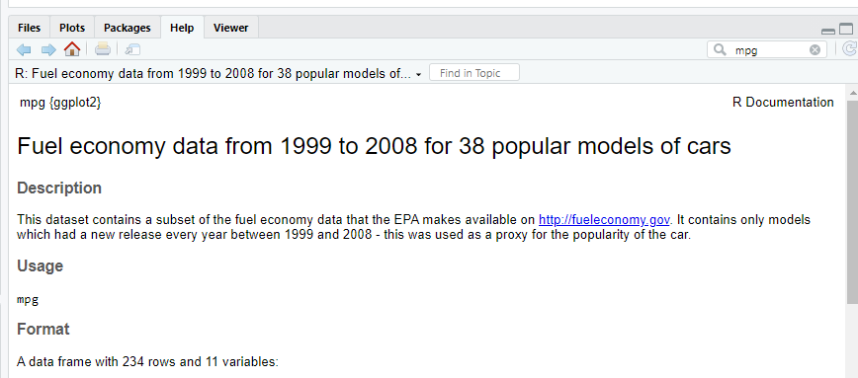
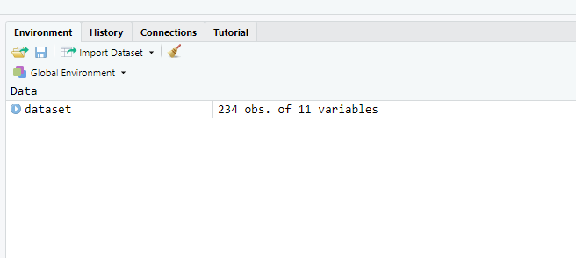
Assign the dataset
We are going to be working with one of the data sets included the ggplot2 library
Entering the mpg name into the help function gives us a description of the data set.
It contains the fuel economy data for 38 different models of cars between 1999 and 2008
It contain 234 observations (rows) with 11 variables (columns)

Slide 10
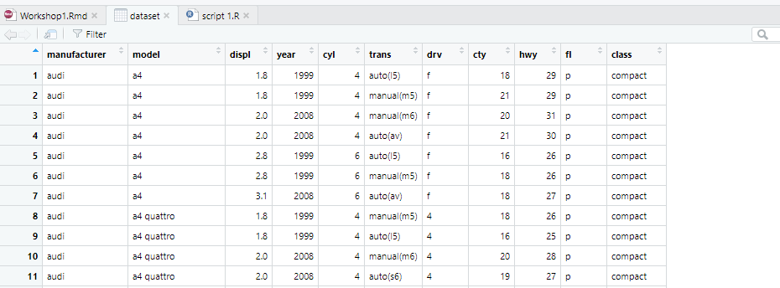
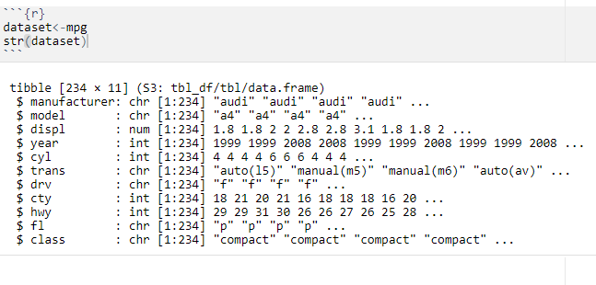
View the Dataset
By clicking on the data set name you can view the observations
The STR function provides us with more information about the format of the data, from this we can start planning the best ways in which we can analyze the data
Now we can move on with some analysis

